Slide 1
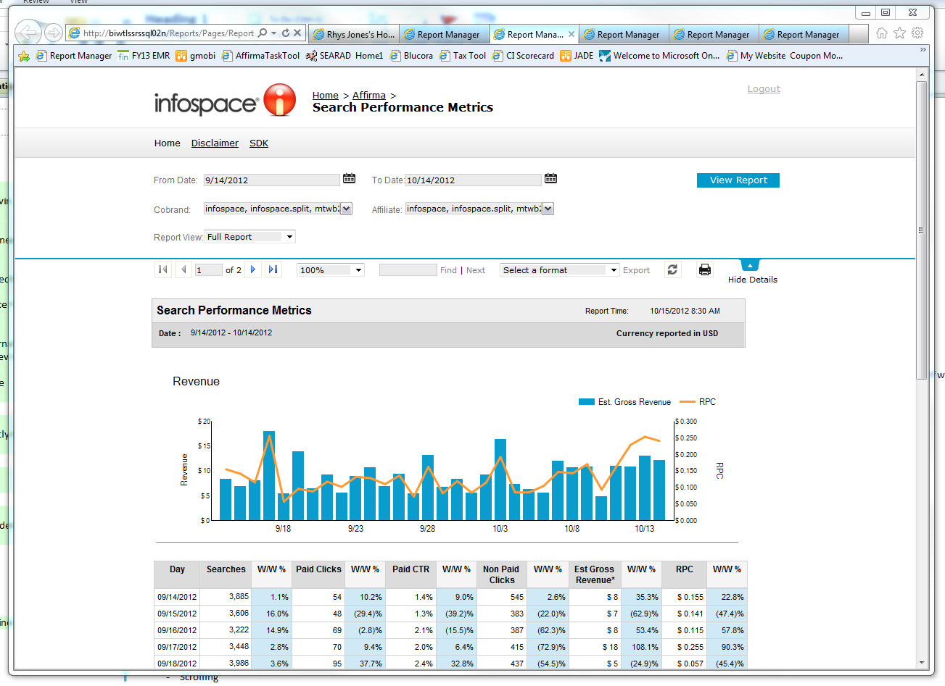
Infospace Reporting Portal
The Challenge
Blucora came to Affirma when they wanted to improve market share and regain competitive advantage. Blucora’s business model revolves around aggregating web data for clients and providing that data via SSRS 2008 reports. Limited by the bland SSRS default portal design, Blucora needed to update the visual appeal of these reports in order to tackle their emerging competition. Affirma was engaged to turn a standard SSRS portal into a visually stunning and interactive tool for clients.
What We Did
• Affirma re-designed existing SSRS reports, while creating custom skins and functionality for the SSRS 2008 portal.
• Historically, making customizations to any SSRS default portal had never been done before. Without any precedent for turning the standard SSRS portal into something visually appealing, Affirma’s team developed a creative and unique way to do so using JQuery, CSS and JavaScript.
Results
Initial feedback has been very positive. The client plans to go live with the new portal and updated reports December 2012.

